Slide 1
British Airways Passenger Review Insights
Analysis of Recommendations, Ratings, and Traveler Patterns

Slide 2

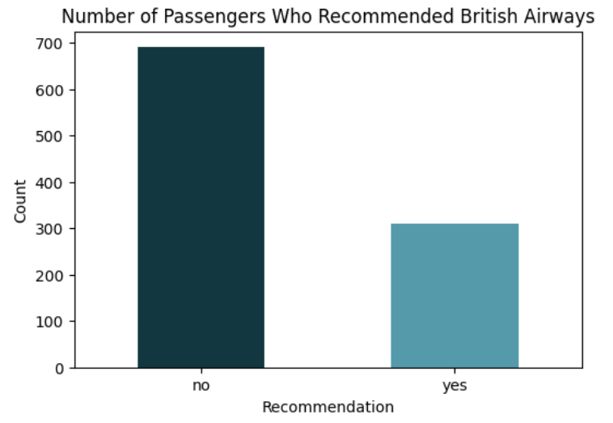
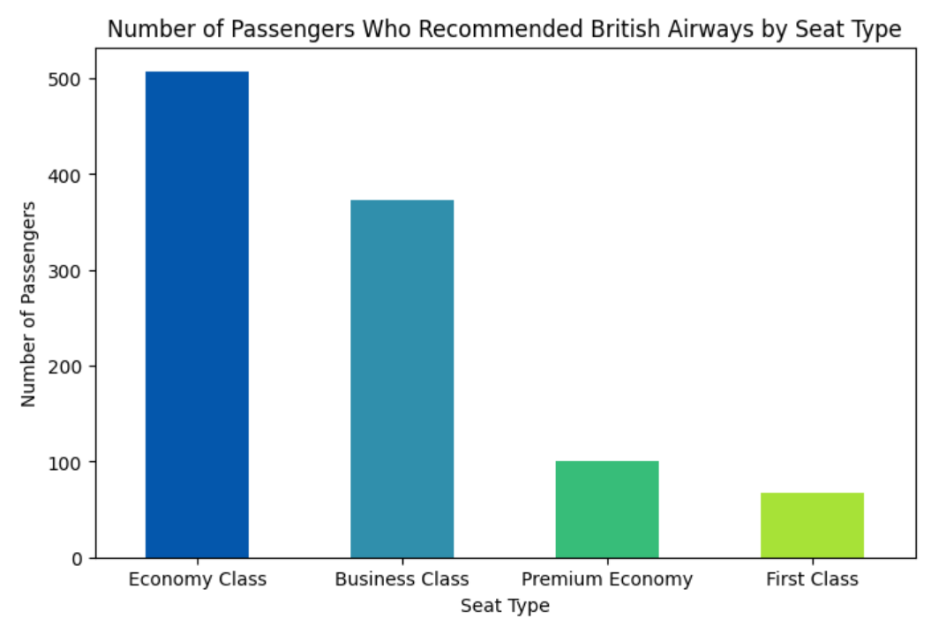
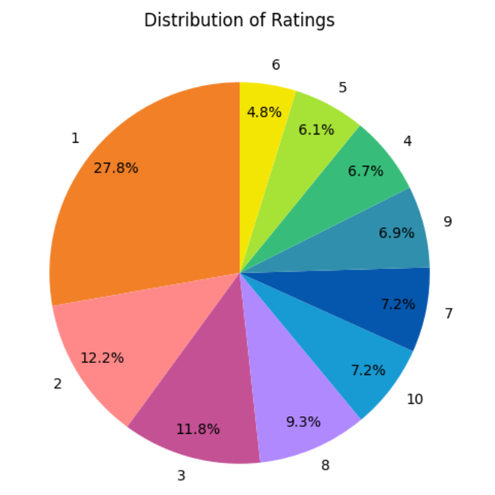

Between 2019 and 2025, over 500 passengers gave positive feedback, around 450 gave negative, and more than 20 provided neutral reviews.
The most extreme frequent issues reported were flight delays, long waits, staff Service, refund concerns, seat comfort, luggage problems, and flight cancellations.
Passengers gave the most negative reviews for the London to Malaga route, while the Vancouver to London route received the highest recommendations

